Slide 1

The WEIRD Problem in a“Non-WEIRD” Context: A Meta-Research on the Representativeness of Human Subjects in Chinese Psychological Research
2025.01.14
华中师范大学研究生会

Slide 2

Introduction
Method
Content
Preliminary results
Research progress

Slide 3
01
Introduction

Slide 4
Research background
Psychological science aims at understanding human mind and behaviour. However, psychological science largely relies on unrepresentative human samples: most human participants in published psychological studies are undergraduate students who take psychology courses from “Western, Educated, Industrialized, Rich, and Democratic” regions (Henrich et al., 2010a; Henrich et al., 2010b; Henry, 2008; Sears, 1986)
WEIRD
华中师范大学研究生会

Slide 5
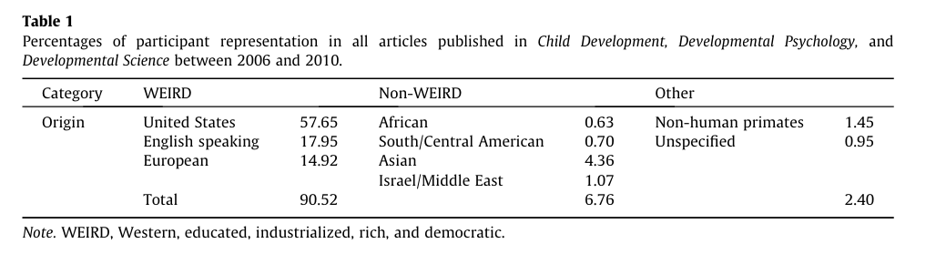
Research background
Nielsen et al. 2017
华中师范大学研究生会

Slide 6
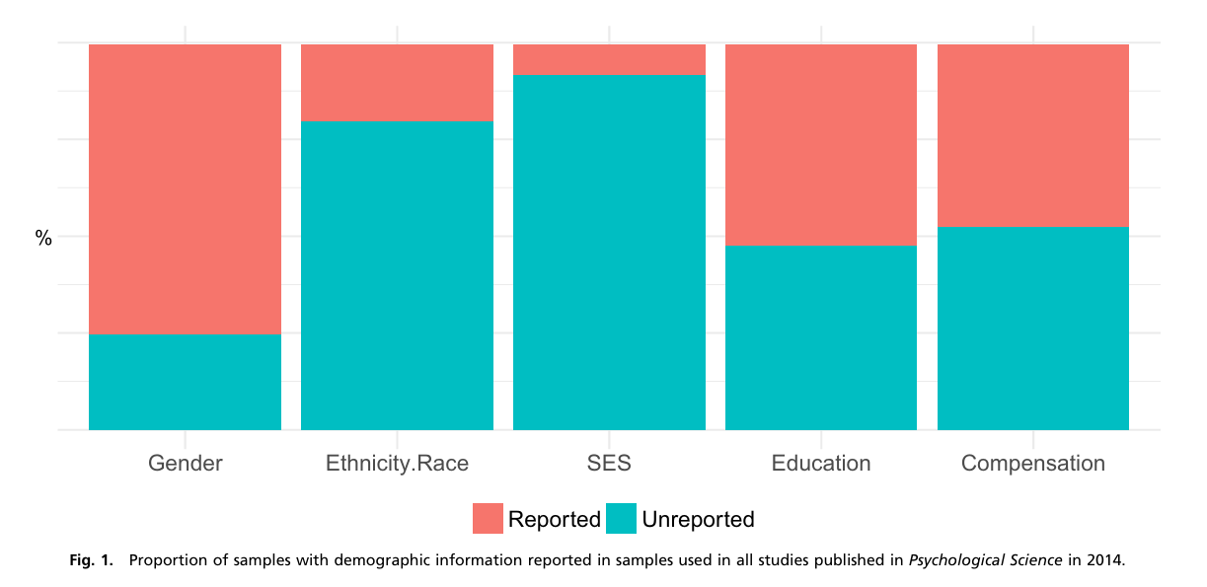
Research background
Rad et al. 2018 PNAS
华中师范大学研究生会

Slide 7
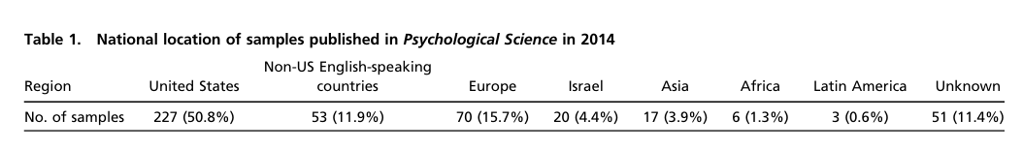
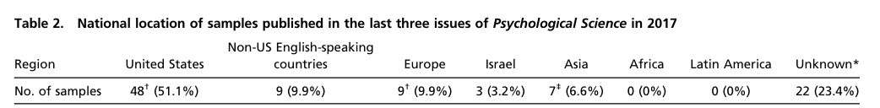
Research background
Rad et al. 2018 PNAS
华中师范大学研究生会

Slide 8
Research background
Note: 本图由Rad et al. 2018和2022世界人口数据整合而成。
华中师范大学研究生会

Slide 9
Research background
limitting our understanding of the whole picture of human mind and behaviour
WEIRD problem
leading to incorrect policies
华中师范大学研究生会

Slide 10
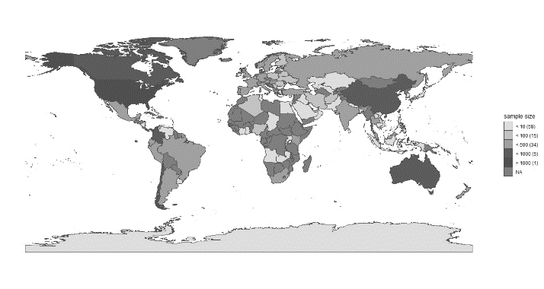
Research background
？
Representativeness？
International collaborations projects
PSA
Human Penguin Project
Non_WEIRD data
Asia, Middle East,
Latin America, and Africa
华中师范大学研究生会

Slide 11
Question and hypothesis
问题1：来自中国五大权威心理学期刊中的被试特征与来自国际合作项目中的中国被试特征是否相似？
相似
问题2：与人口普查数据和CFPS相比，心理学研究中的中国被试在多大程度上能代表中国人？
代表性差
问题3：其国家或地区被研究的对象是否和中国的被试有一样的特征？
是
华中师范大学研究生会

Slide 12
02
Method

Slide 13
Data resource
中国临床心理学
心理学报
心理与行为研究
心理科学
心理发展与教育
...
Journal
Data source
International collaborations projects
华中师范大学研究生会

Slide 14
Data resource
中国临床心理学
Wang et al. (2021)
2017~2018 500 Articles
心理学报
心理与行为研究
心理科学
心理发展与教育
...
2008 250 Articles
2020~2021 250 Articles
Journal
1000 Articles
王珺 等. (2021). 解读不显著结果：基于500个实证研究的量化分析. 心理科学进展 , 29(3), 381-393.
华中师范大学研究生会

Slide 15
Data resource
Journal | 2008 | 2017~2018 | 2020~2021
Acta Psychological Sinica | 138 (39) | 246 (95) | 91 (28)
Journal of Psychological Science | 379 (107) | 299 (115) | 203 (61)
Chinese Journal of Clinical Psychology | 227 (64) | 379 (146) | 310 (94)
Psychological Development and Education | 87 (24) | 162 (62) | 95 (29)
Psychological and Behavioral Studies | 57 (16) | 213 (82) | 125 (38)
Note: Each column includes the total number of articles published in each journal at that time interval and the number of articles selected (inside parentheses)
华中师范大学研究生会

Slide 16
Data resource
20081001
20081001
20081002
20081002
20083053
20083053
20081001
20081002
20181053
20181053
心理学报
心理学报
20183053
20183053
20213053
20213053
Check
R
Article number
Data code
Random sampling
华中师范大学研究生会

Slide 17
Data code
Formal coding stage
pre-coding stage
Coding proofreading stage
华中师范大学研究生会

Slide 18
Data code
1000
Code manual
华中师范大学研究生会

Slide 19
Data code
Article basis info: title, first-author, journal…
Subjects info: gender, age, SES, subjects number,
subjects recruitment area…
Code manual
Other important info: target population,
sampling method, subjects recruitment method,
study type
华中师范大学研究生会

Slide 20

Data analysis
pre-process and visualise data
Bayes factor (Bayesian multinomial test)
华中师范大学研究生会

Slide 21
03
Preliminary results

Slide 22
Coding consistency
To ensure the accuracy of coding content, after initial coding, two coders from the same group will assess the consistency of each article's coding using a Likert scale ranging from 1 to 3, representing complete disagreement, partial agreement, and complete agreement, respectively. All entries in the coding manual, except for "Coding Basis" and "Remark 3," require such ratings. The results indicate that the consistency scores for all entries lie between 2.62 and 3, significantly above the average score of 2 on a three-point scale (One-sample one-tailed t-test: ts > 32.80, ps < 0.001, Cohen’s ds > 0.80, the detailed information see Chin_Subj_check_data.jasp).
华中师范大学研究生会

Slide 23
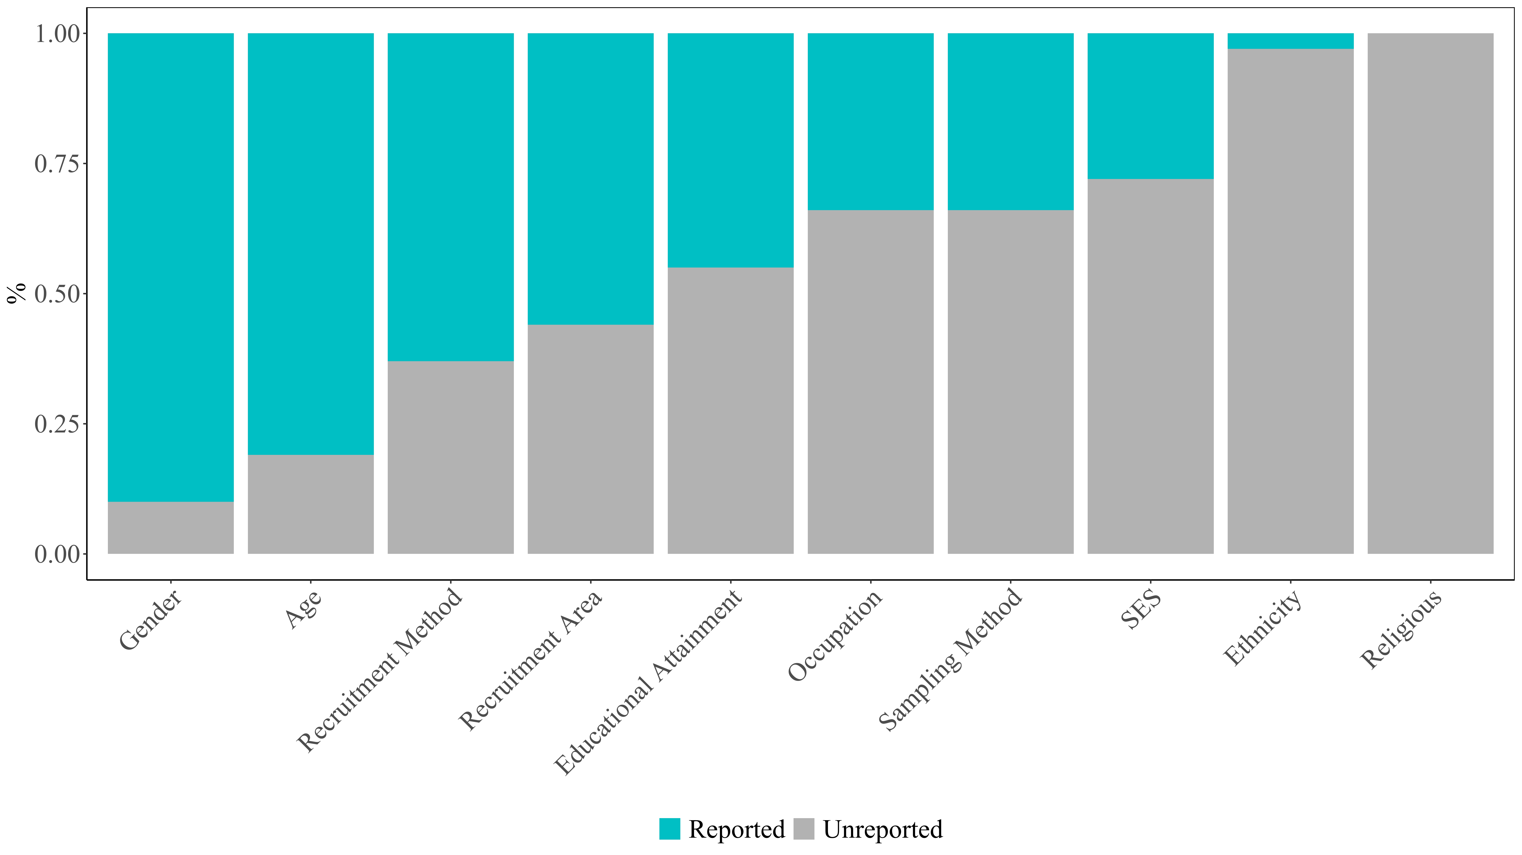
Reports of Chinese journal
962 articles (1,217 studies, a total of 538,552 subjects) met our inclusion criteria for further analysis
only age ranges or other ambiguous age information (e.g., subjects age is 22~54)
华中师范大学研究生会

Slide 24
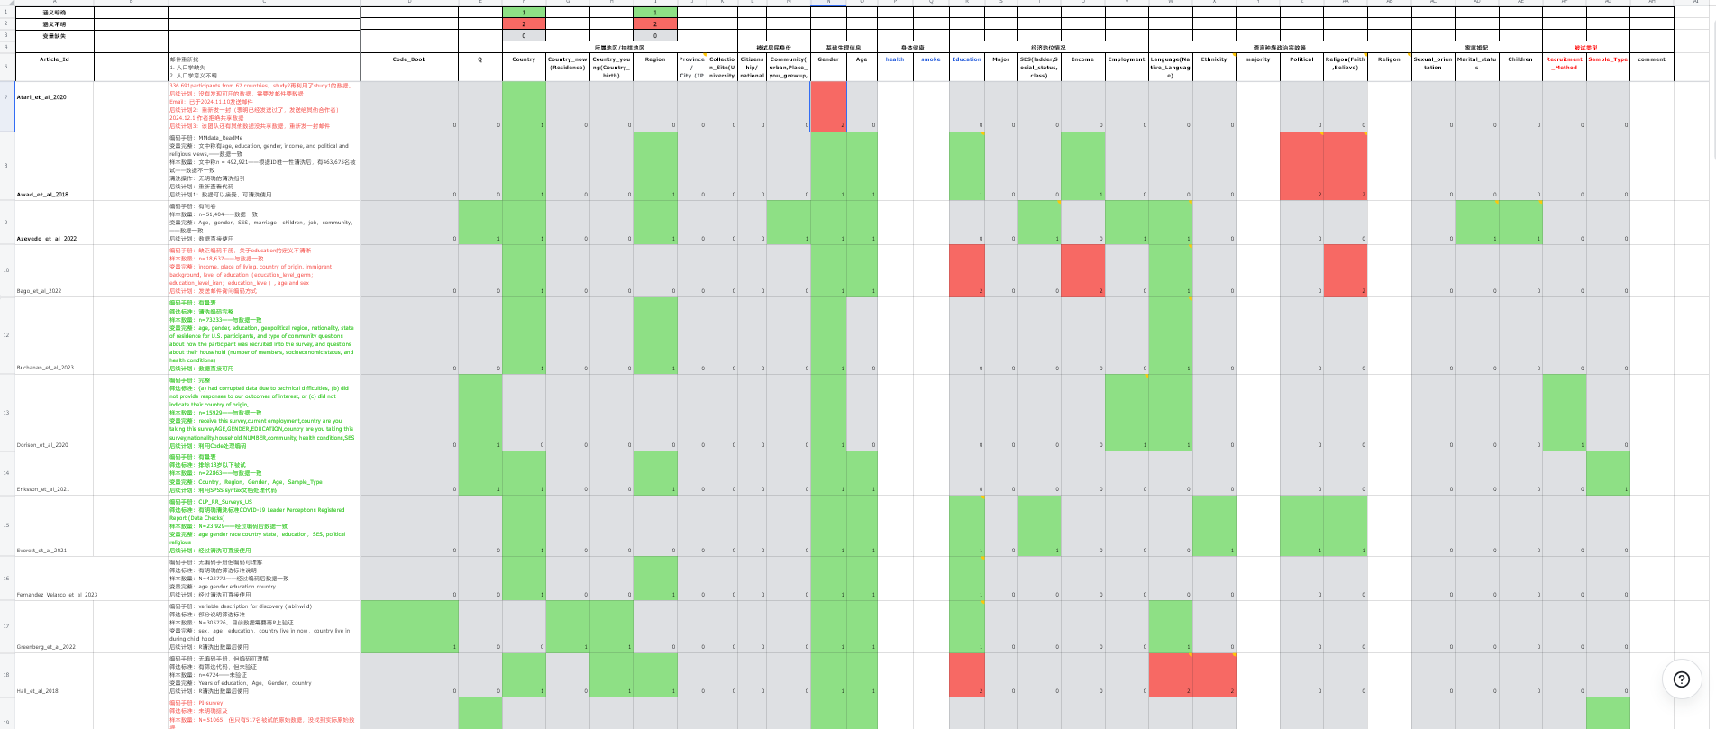
Large scale international collaboration projects
华中师范大学研究生会

Slide 25
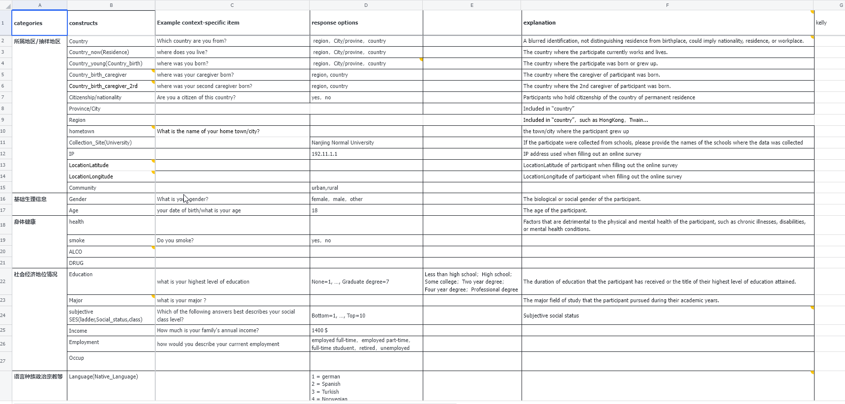
Large scale international collaboration projects
华中师范大学研究生会

Slide 26
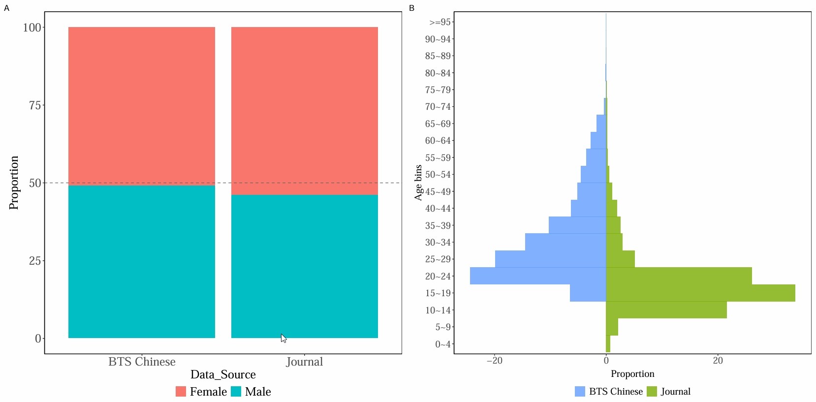
Q1
age 25-64 in large-scale international collaborations is nearly four times or more than that of Chinese papers
华中师范大学研究生会

Slide 27
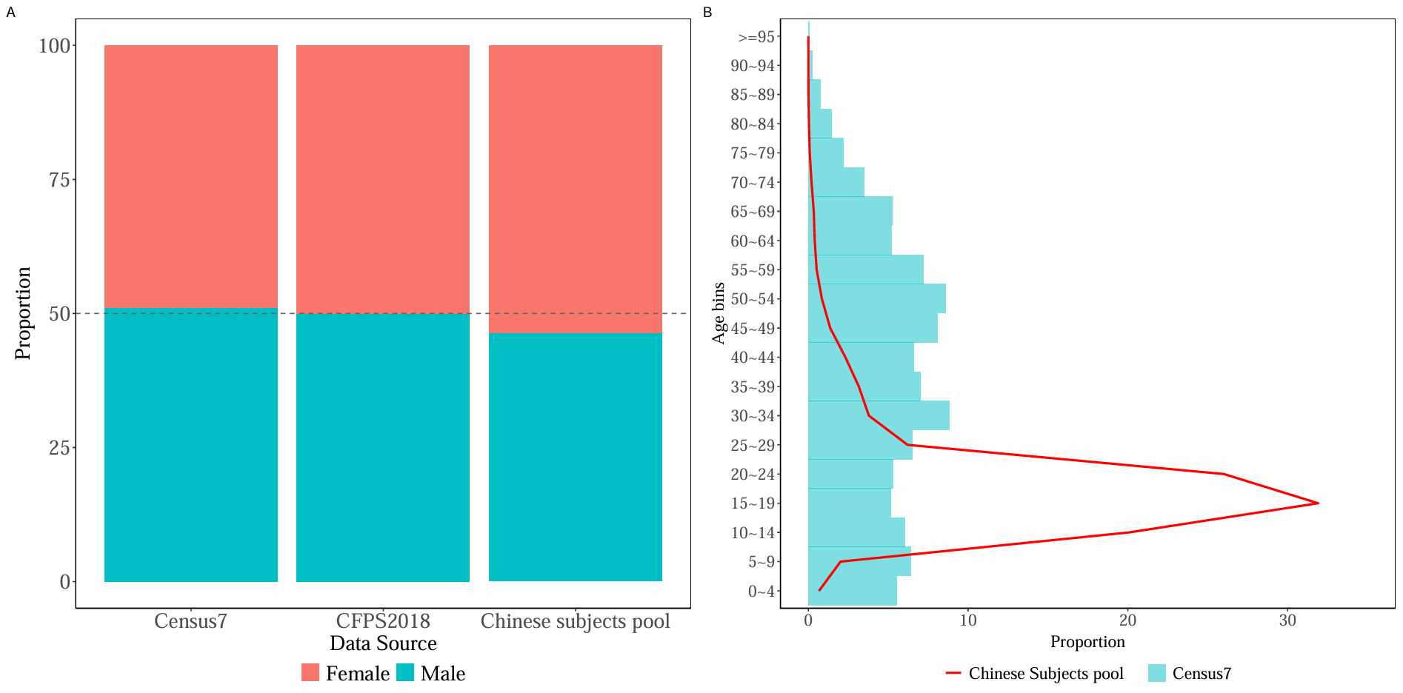
Q2
Chinese subject pools are mainly composed of people aged 10-24, and these people are usually students.
华中师范大学研究生会

Slide 28
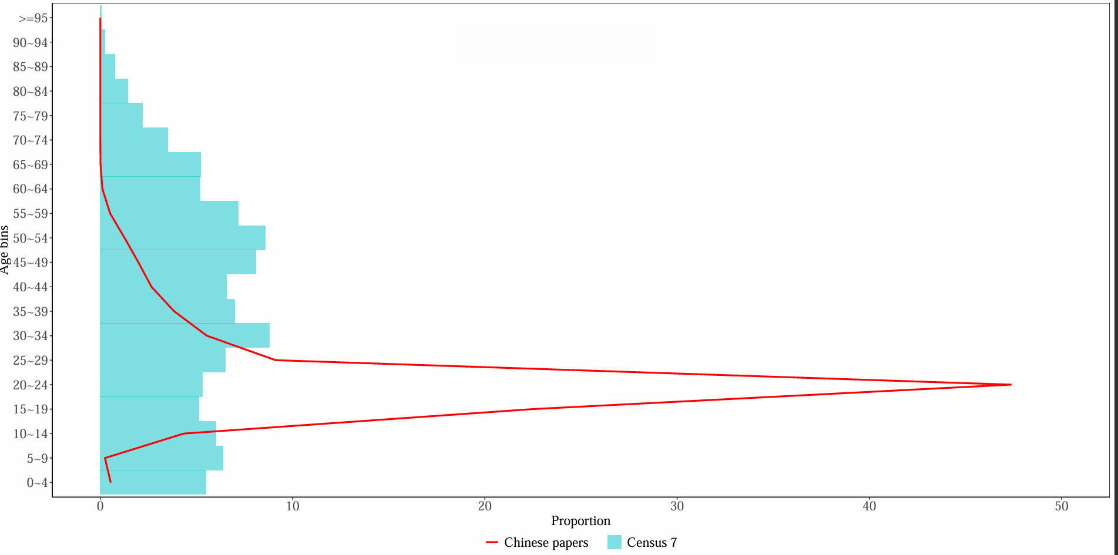
Q2
华中师范大学研究生会

Slide 29
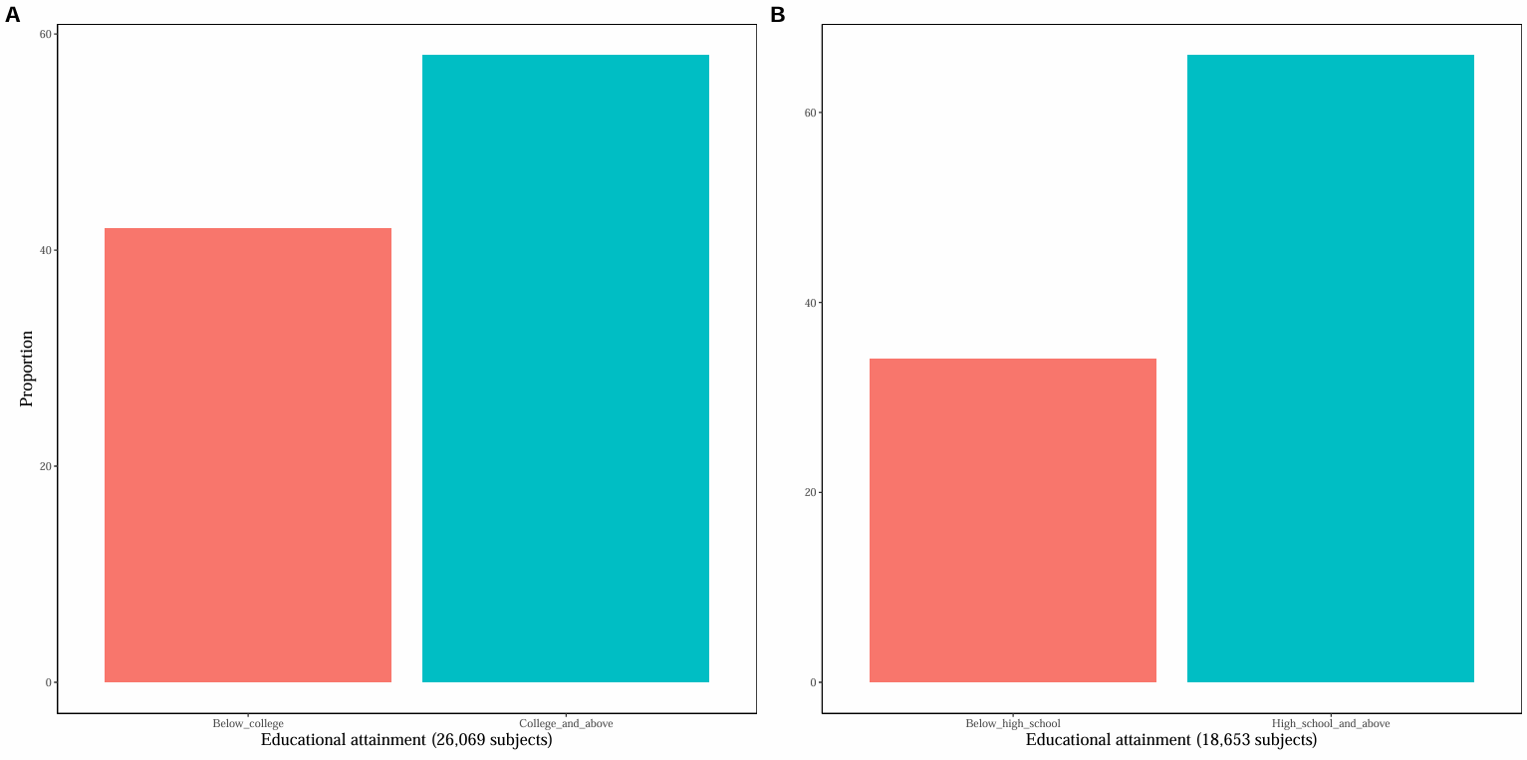
Q2
华中师范大学研究生会

Slide 30
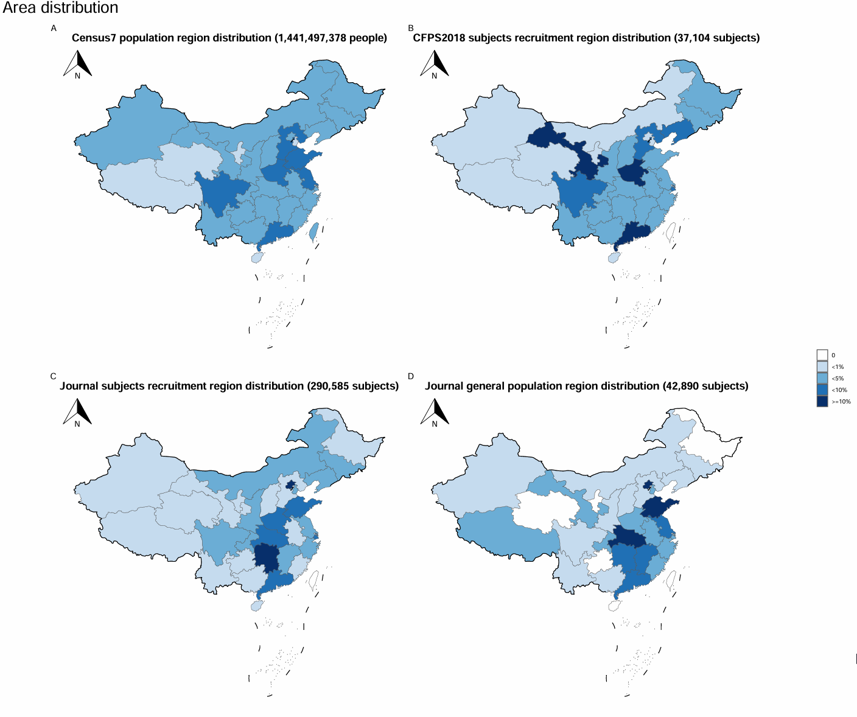
Q2
华中师范大学研究生会

Slide 31
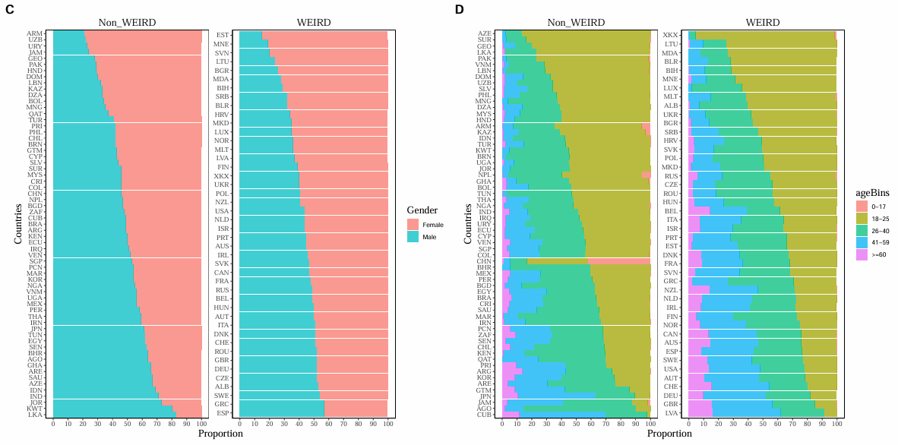
Q3
华中师范大学研究生会

Slide 32
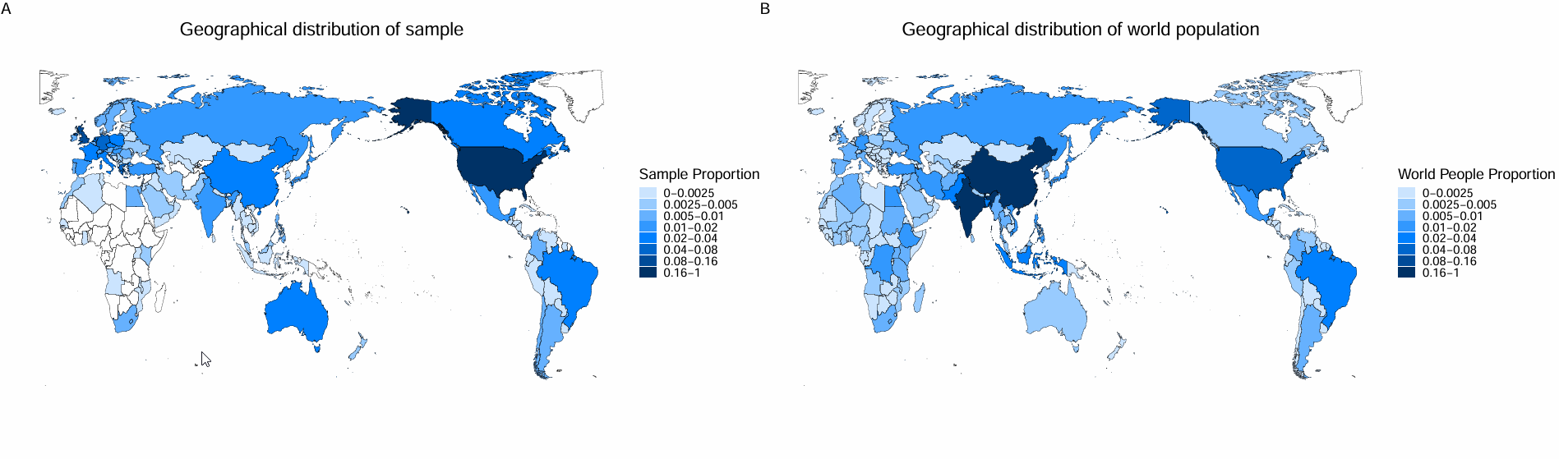
Q3
华中师范大学研究生会

Slide 33
04
Research progress

Slide 34



Research progress
2021.03
2021.05
2021.09
赵加伟, 夏涛, 胡传鹏. (in press). 心理学研究中预注册的现状、挑战与建议. 心理科学进展
华中师范大学研究生会

Slide 35
Research progress
2 round +
3 round
5
Registered reports
Stage 1 in-principle acceptance 2023.04.03
Coding
华中师范大学研究生会

Slide 36
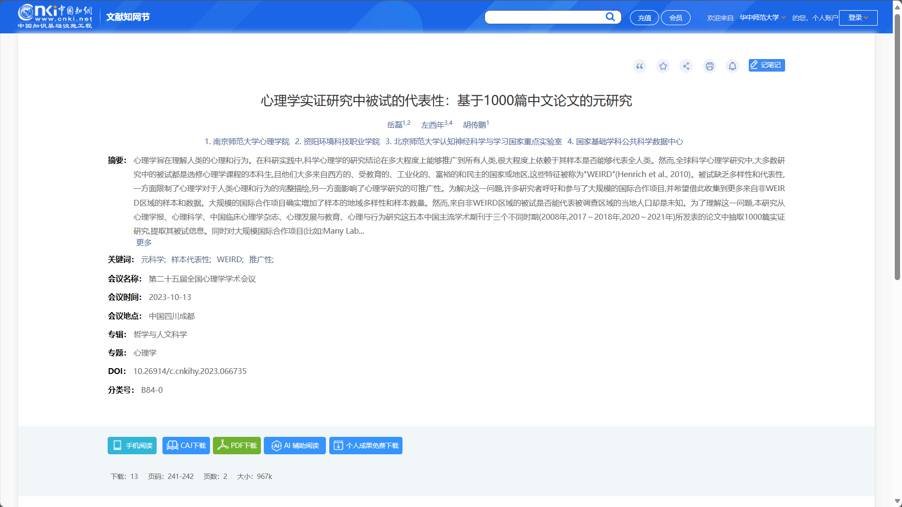

Research progress
2023.12.17 finish coding
Data pre-process and
data collection
2023 25th NACP
华中师范大学研究生会

Slide 37
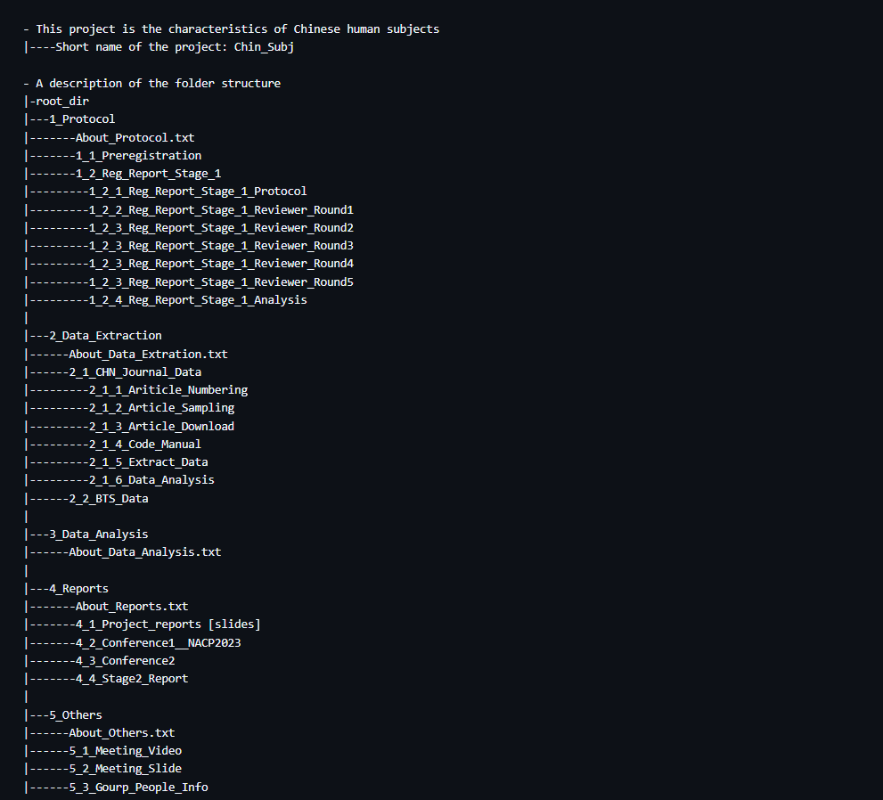
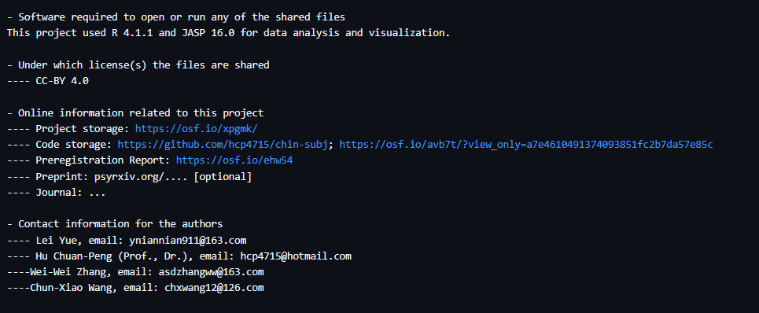
Folder structure
2023 25th NACP
华中师范大学研究生会

Slide 38
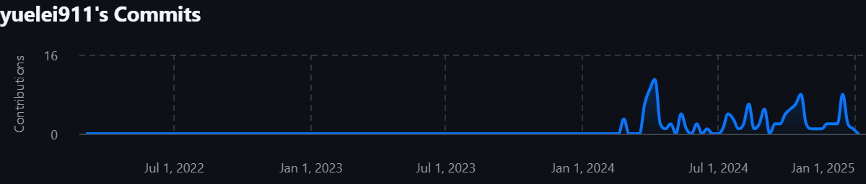
Github commit
华中师范大学研究生会

Slide 39
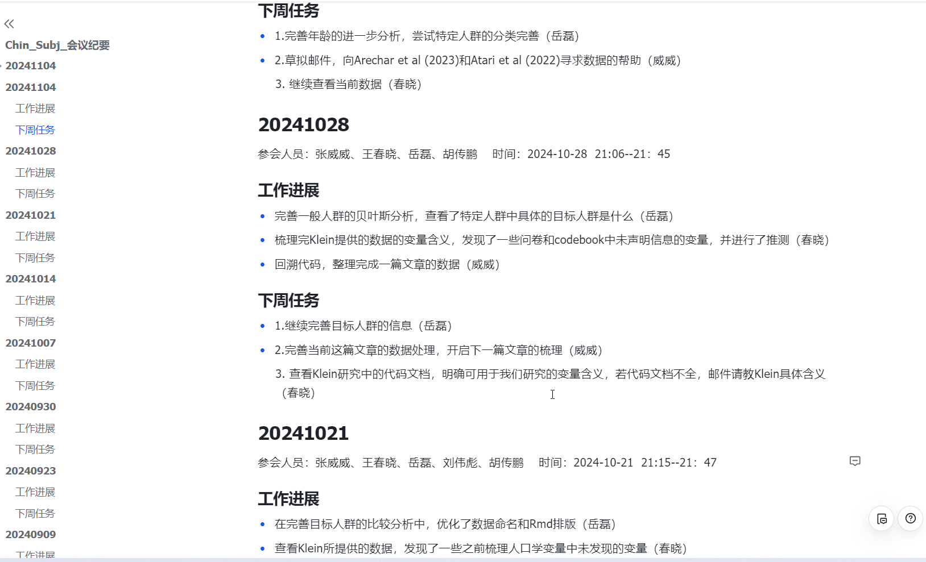
Project meeting
2023 25th NACP
华中师范大学研究生会

Slide 40

Research progress
扫描二维码获取
我们的注册报告文档
华中师范大学研究生会

Slide 41



微信即可扫码关注公众号元自我和OpenScience

